Slide 1
RE1 – Binary to C
Presented by Christopher Doege

Slide 2
Topics Covered
Binary (Review)
1 and 2s compliment
Truth Tables (AND, OR, XOR)
Hex (Review)
Converting Binary to Hex
Common Values
Logic Gates

Slide 3
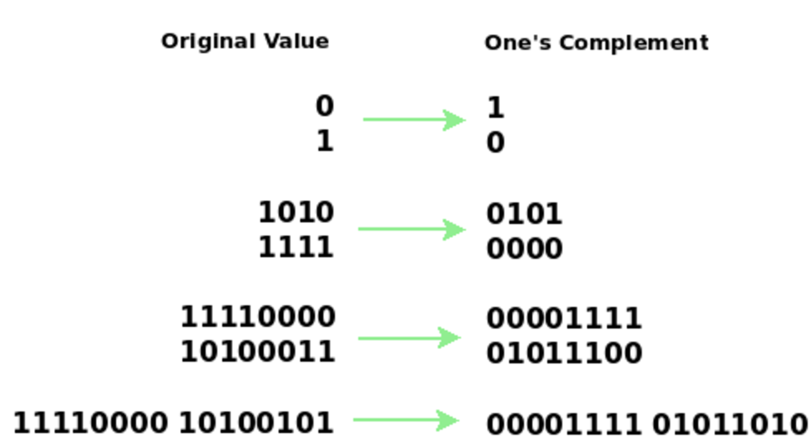
1s Complement
Invert all bits

Slide 4
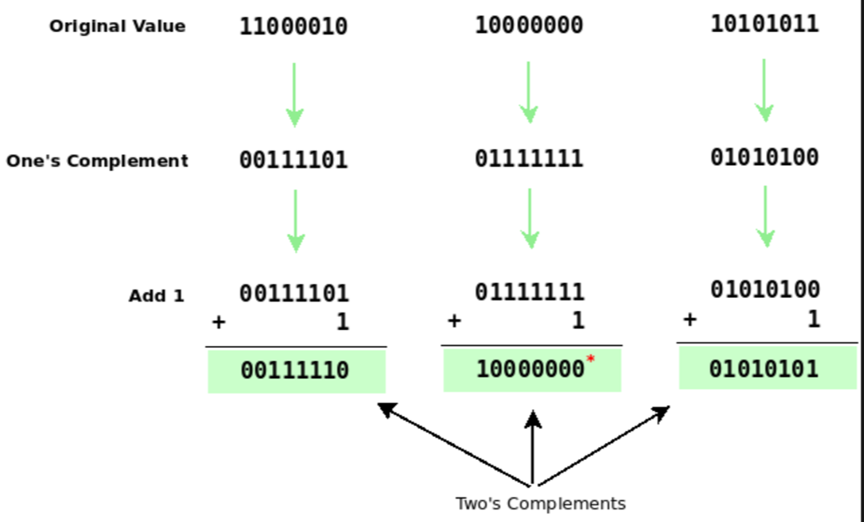
2s Compliment

Slide 5
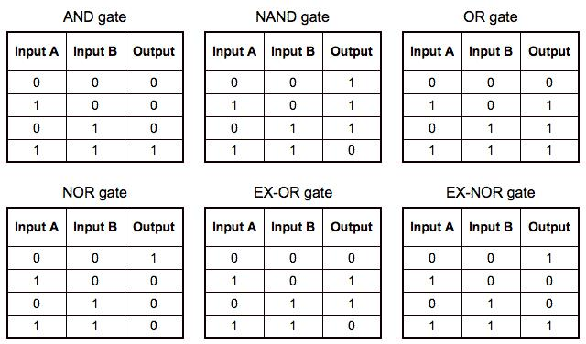
Truth Tables:

Slide 6
Hex
Numbering System
1,2,3,4,5,6,7,8,9,A,B,C,D,E,F
Conversion of binary digits to Hex
Binary: 1100 1111 Hex: 0xCF
Conversion nibble by nibble
a

Slide 7
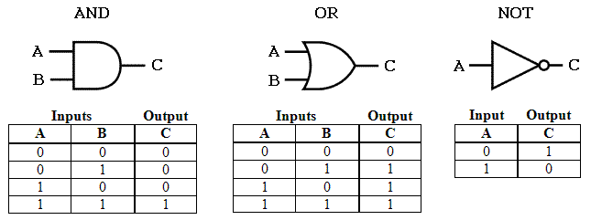
And, Or and Not Gates

Slide 8
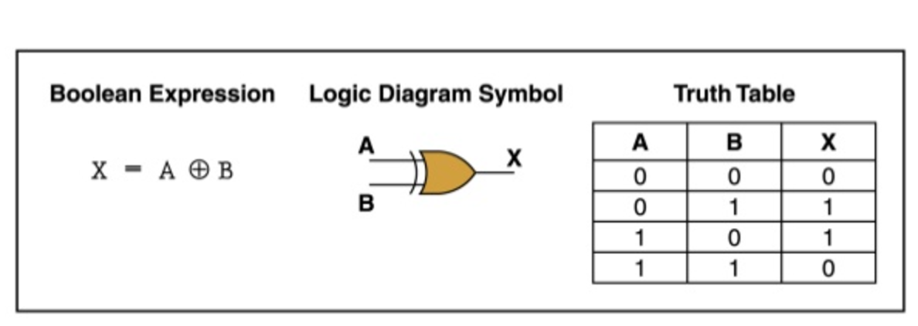
XOR Gate

Slide 9
C Programming
Common Language for executable formats
Primarily used in operating system development
Below is my intro to C in ~20 minutes

Slide 10
printf
Printf is a function call from stdio.h
printf(“string %<format specifications>,…”, vars,..)
Format specifications:
%i.kc
Where I is the field width, k is the precision and c is the format specified
%c - Char
%s – String
%d – Integer
%lf – Double
For more information man printf

Slide 11
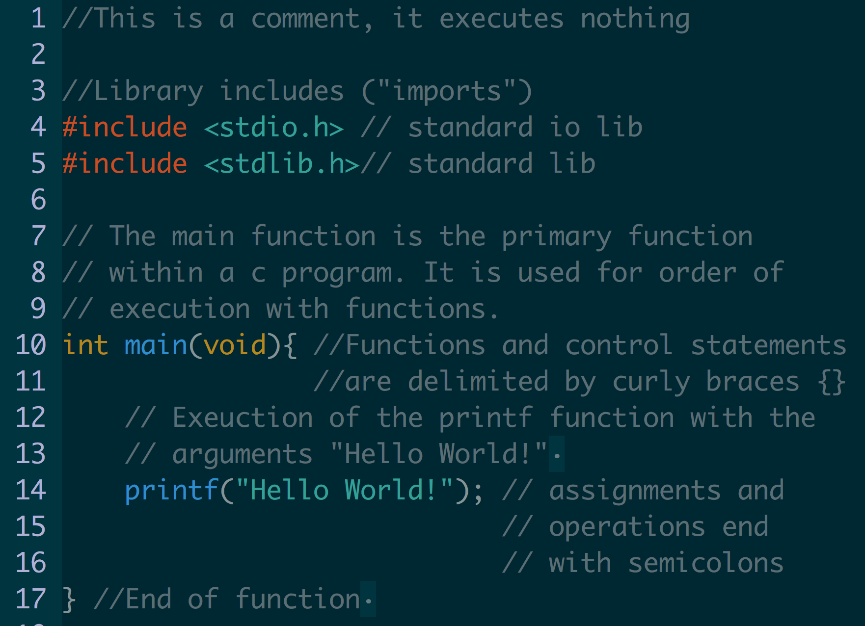

Slide 12
If statements
If, else if, else
Example:
if (a == 1) { //Comparison is == for ints do_something; }else if (a == 2) { do_things; }else { do_stuff; }

Slide 13
Looping structures
For Loop
Declaration:
for (i = 0; i < varA; i++) {…}
Useful for iterating over data
While Loop
Declaration
while (a == 1) {…}
Continues until

Slide 14
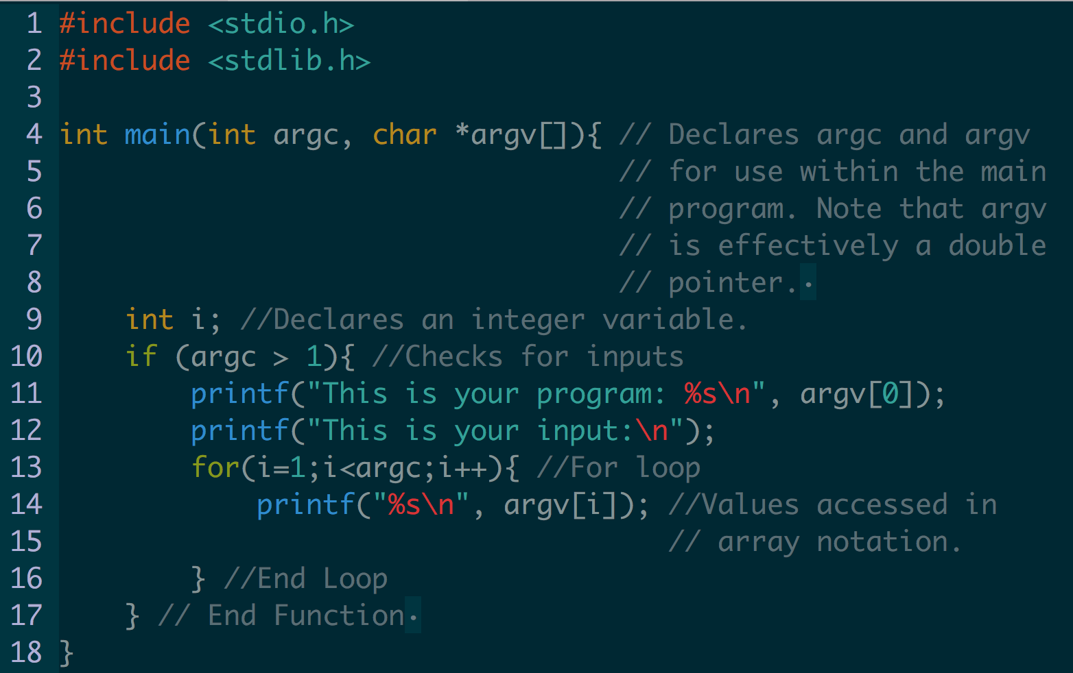
Command Line Input

Slide 15
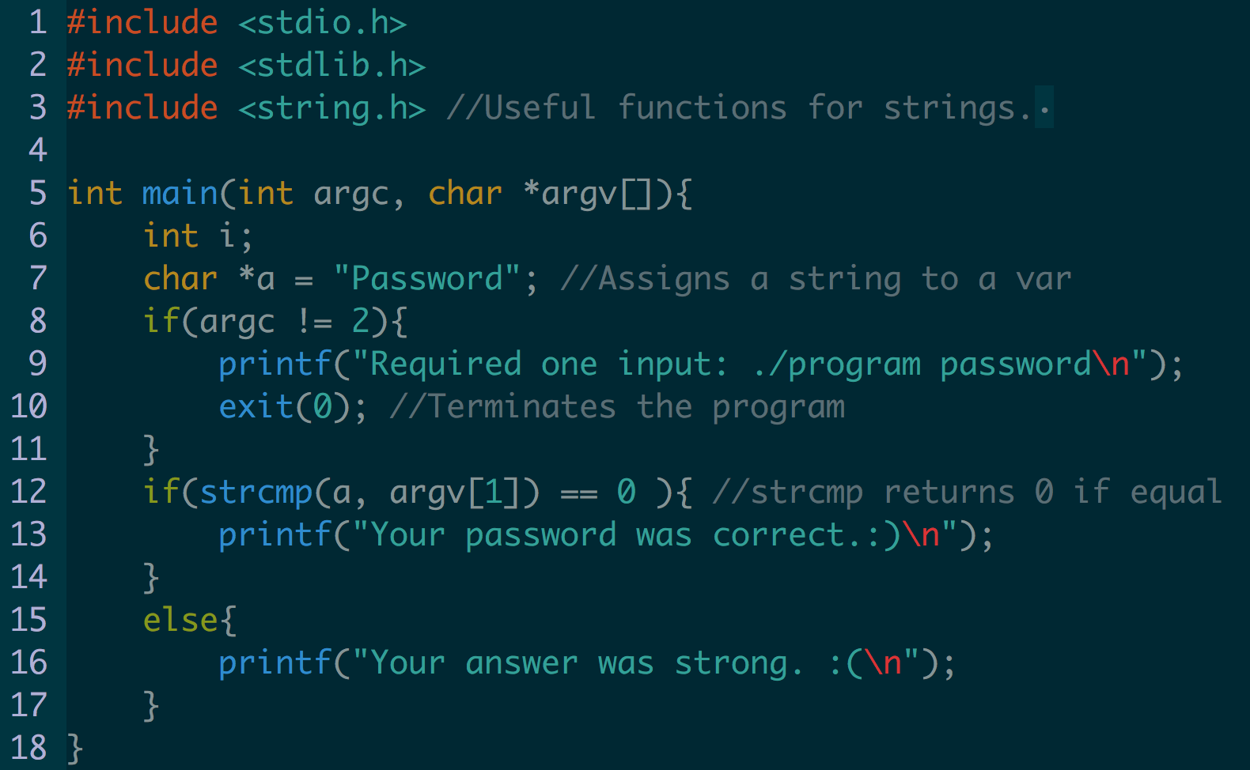
Strings

Slide 16
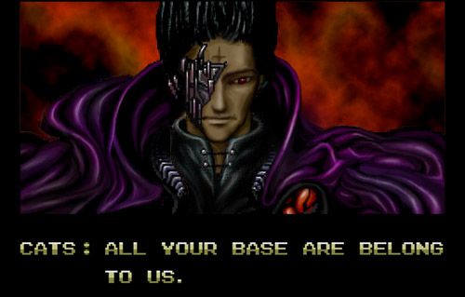
C Programming Demos

Slide 17
Compiler Optimizations
Inlining
Loop unrolling
Loop-invariant code motion
Common sub-expression elimination
Constant folding and propagation
Dead code elimination

Slide 18
Inlining
int foo(int a, int b) { return a + b; } c = foo(a, b+1); c = a + b + 1;

Slide 19
Loop Unrolling
for (i = 0; i < 3; i++) { a[i] = 0; }
a[0] = 0; a[1] = 0; a[2] = 0;

Slide 20
Loop Invariant
for (i = 0; i < 2; i++) { a[i] = p + q; }
temp = p + q; for (i = 0; i < 2; i++) { a[i] = temp; }

Slide 21
Dead Code elimination
i = 1; if (i == 0) { do_things; }
i = 1;

